Slide 1
ENSE 374, Milestone 4
Team Explore The World
Mohamed Bashir, Karlee Fidek, Rishabh Prasad
December 2, 2019

Slide 2
Our Golden Circle
Why: We believe that exploring and expanding one’s knowledge of the world is very important.
How: Inspire people to travel and experience new things by helping them learn about different places around the world.
What: A tool that provides travel recommendations by matching an individual’s preferences to various places around the world.

Slide 3
“Deep Dive”
Gap: Lack of easy to use applications that match user preferences to locations around the world
Vision: Create an app that connects and provides insights to users about various parts of the world based on user preferences
Stakeholders: Individuals who are using the application to help choose their vacation location
Function: Allow people to select preferences and recommend a location and activities
Constraints: limited time, lack of experience coding in CSS, HTML, PHP, MySQL

Slide 4
Teamwork/Responsibilities
Mohamed
Envisioned stakeholders, brainstorming, Golden Circle (m1)
UML diagrams (m2 & m3)
Reflection on process and idea change throughout milestones (m4)
Rishabh
Golden Circle, brainstorming, vision (m1)
Lo-fi interface sketches (m2)
HTML and CSS code (m3 & m4)
Felt confident writing HTML and CSS and designing interface
Karlee
Golden Circle, methodology, constraints, brainstorming (m1)
FRD (m1, m2, m3)
UML diagrams, MVC Diagram (m2 & m3)
PHP and MySQL code, clean code review (m3 & m4)
Only one who had learned PHP and MySQL at the time

Slide 5
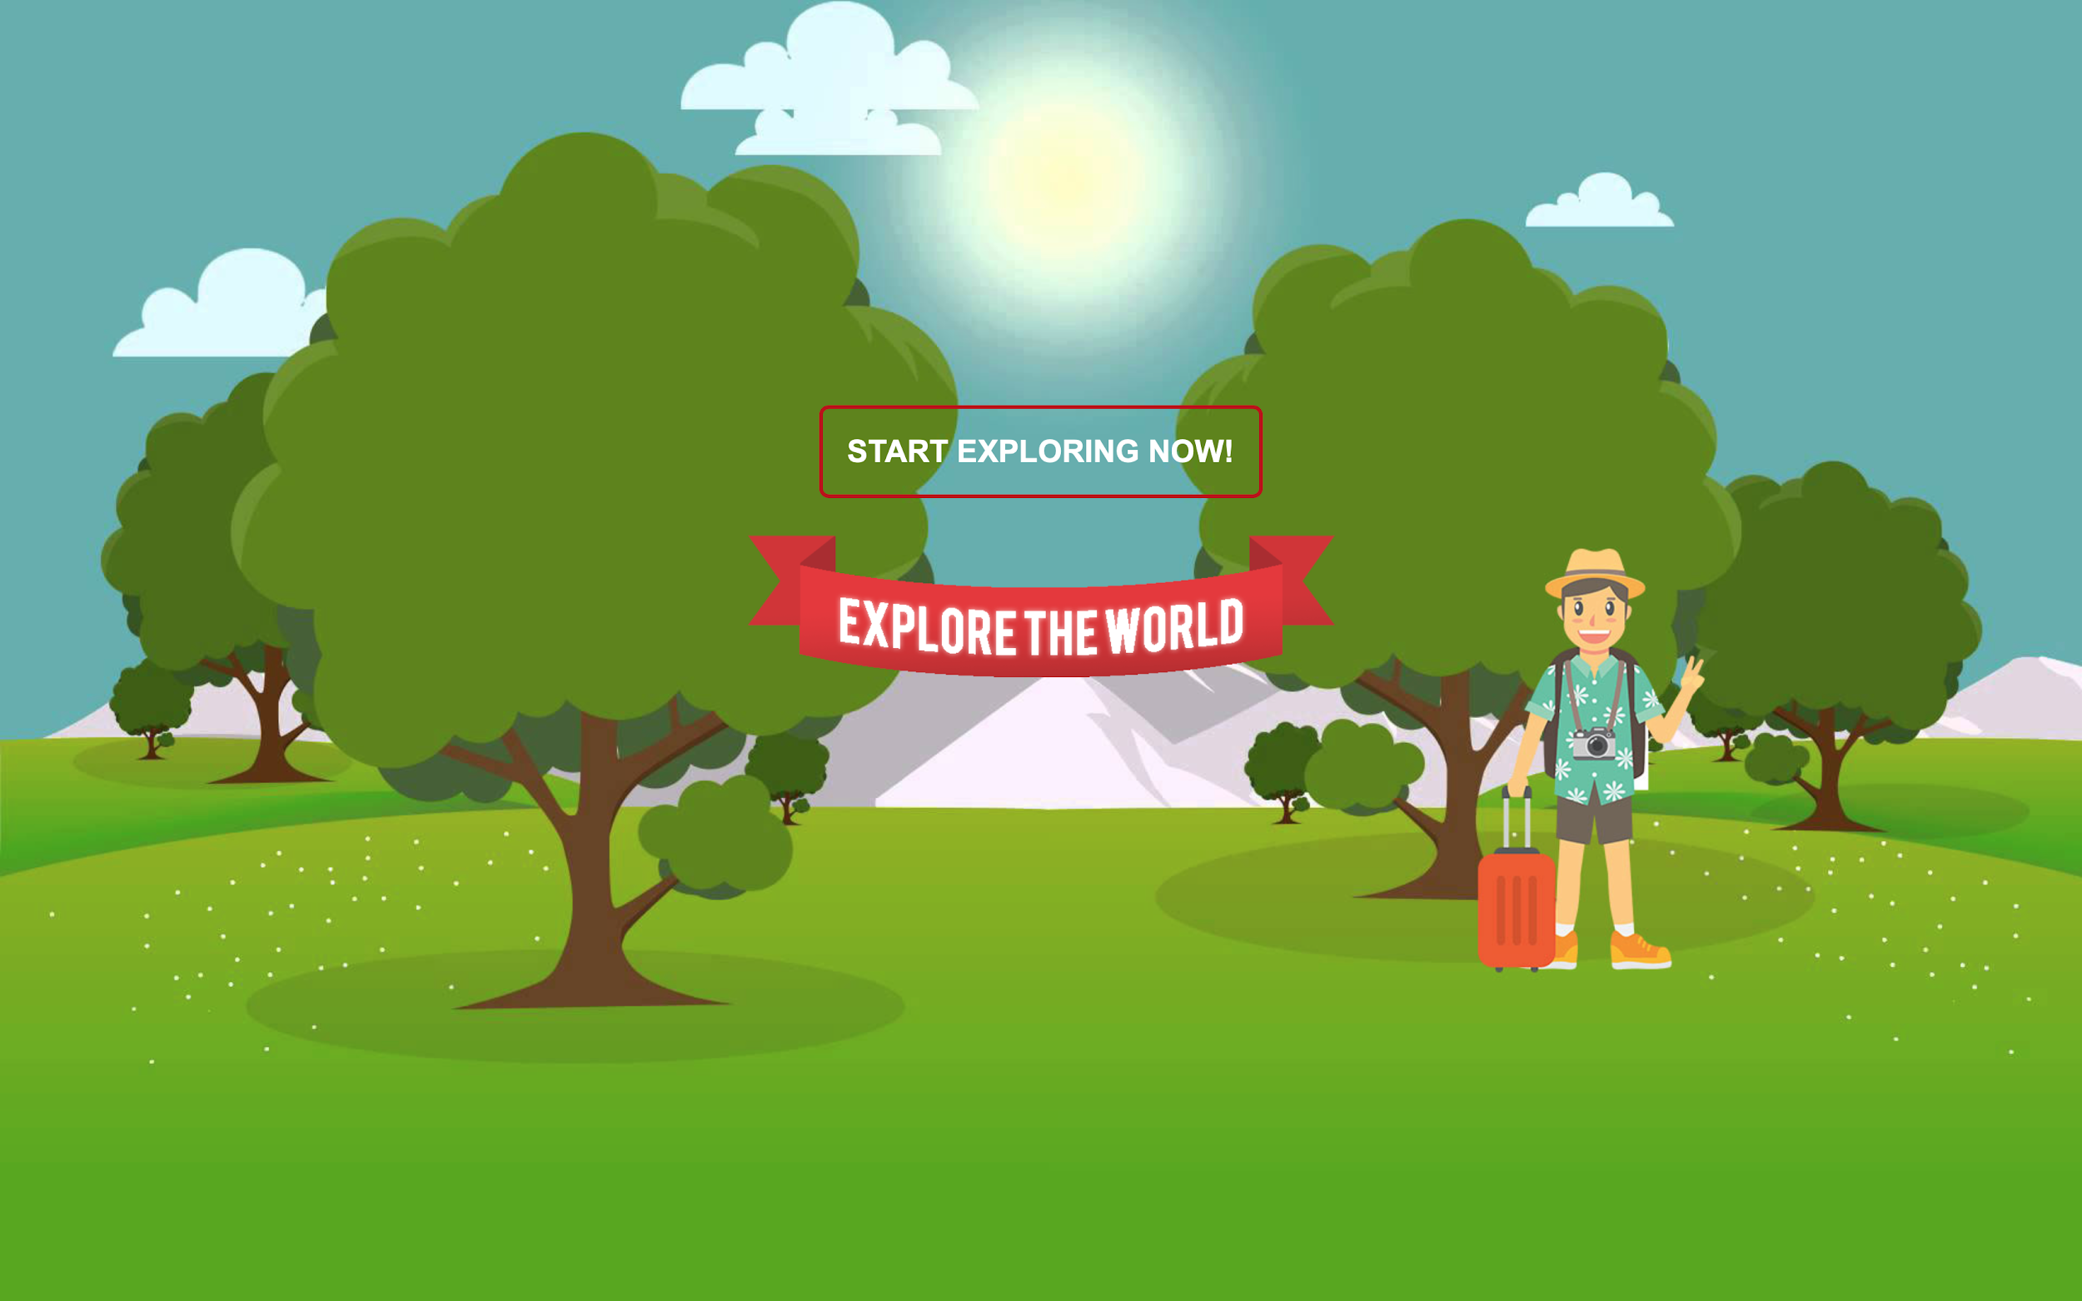
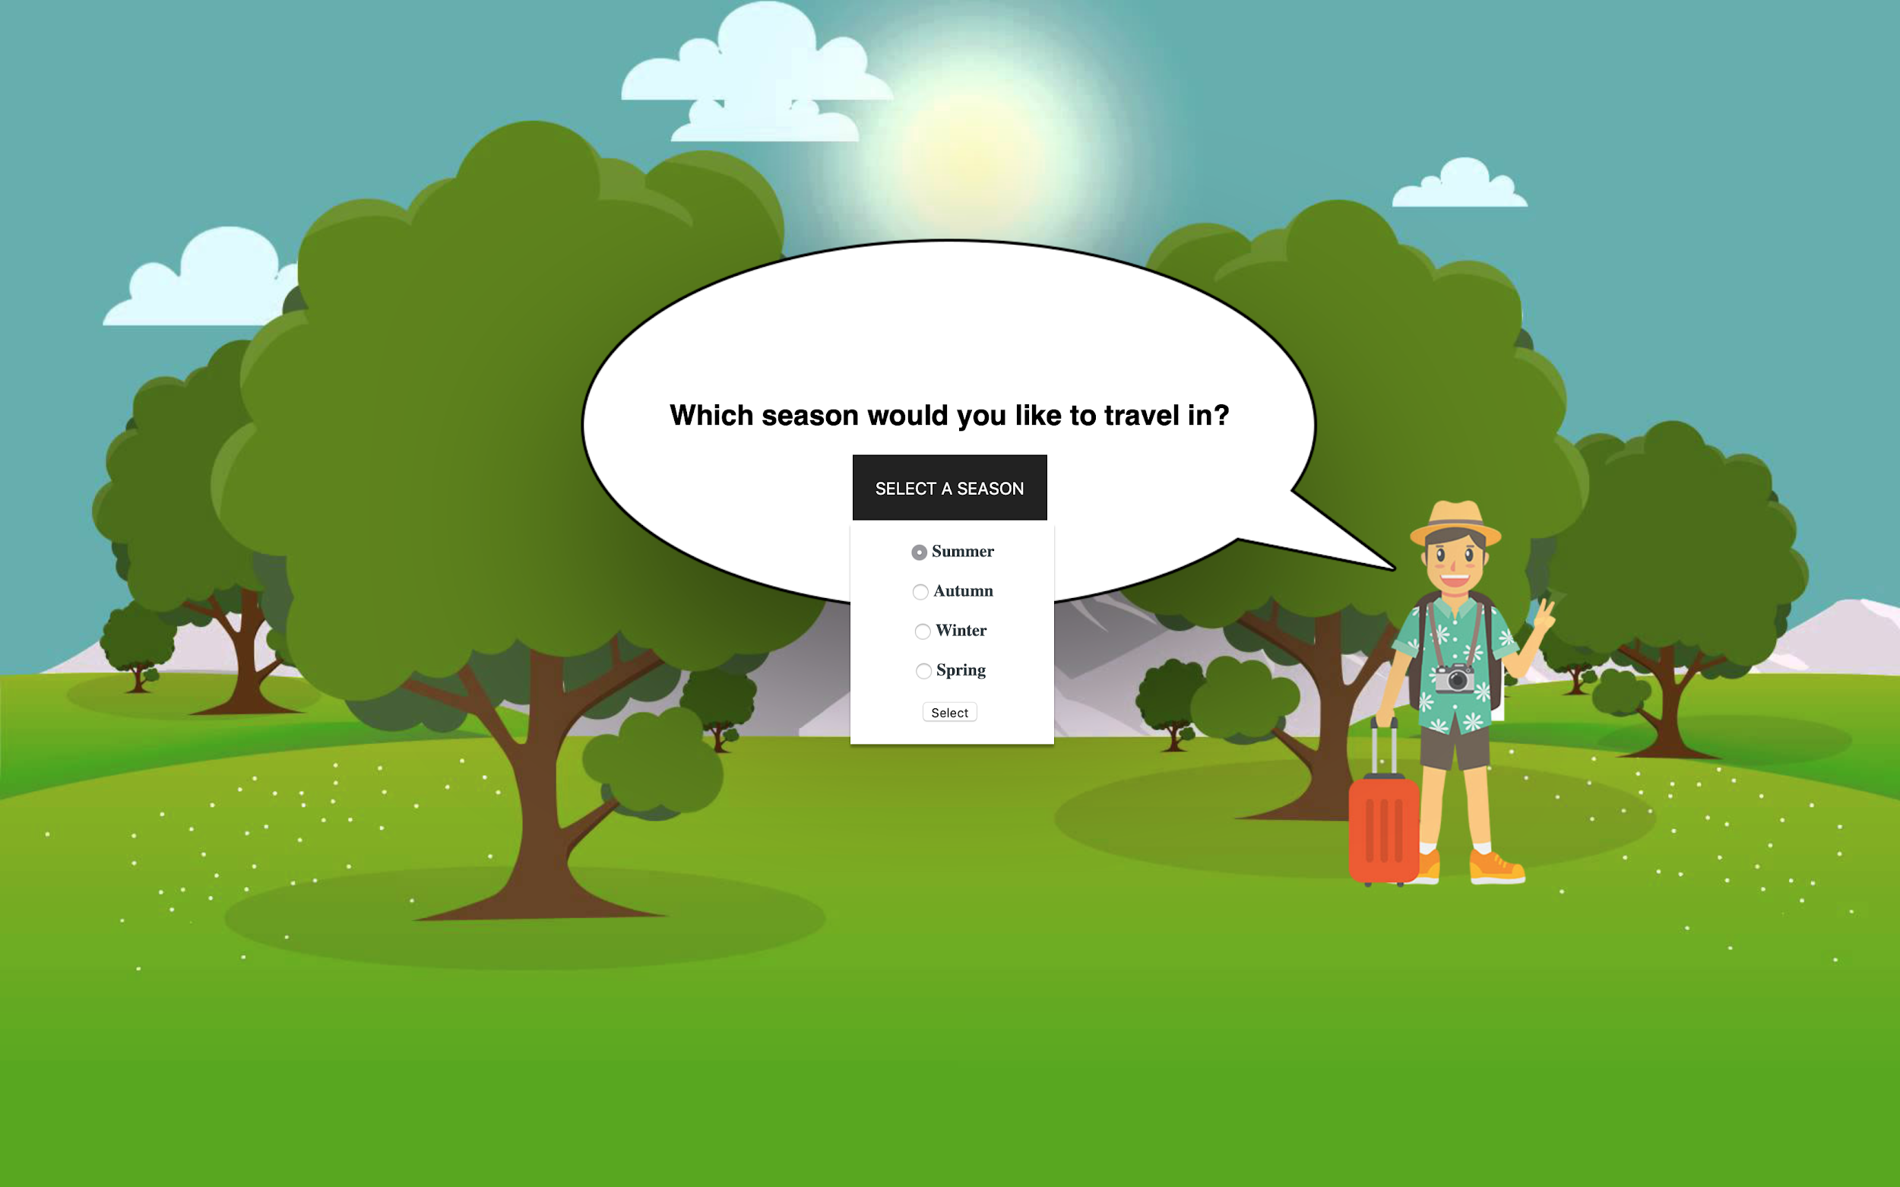
MVP 2 - Interface

Slide 6
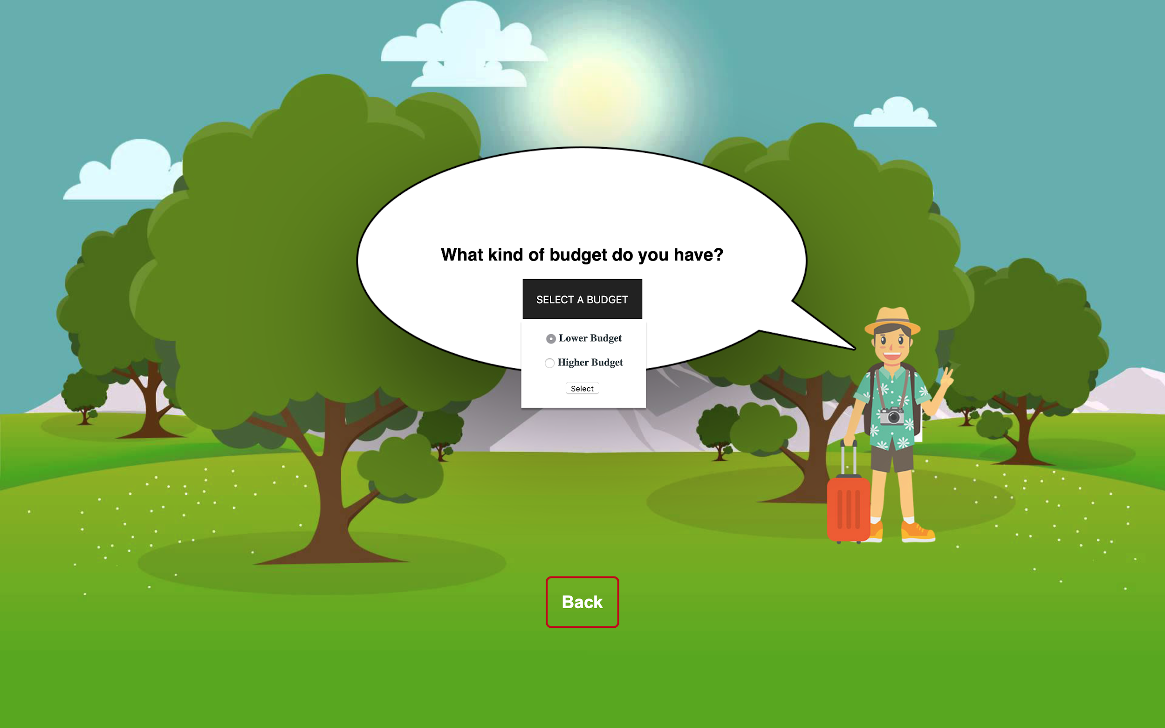
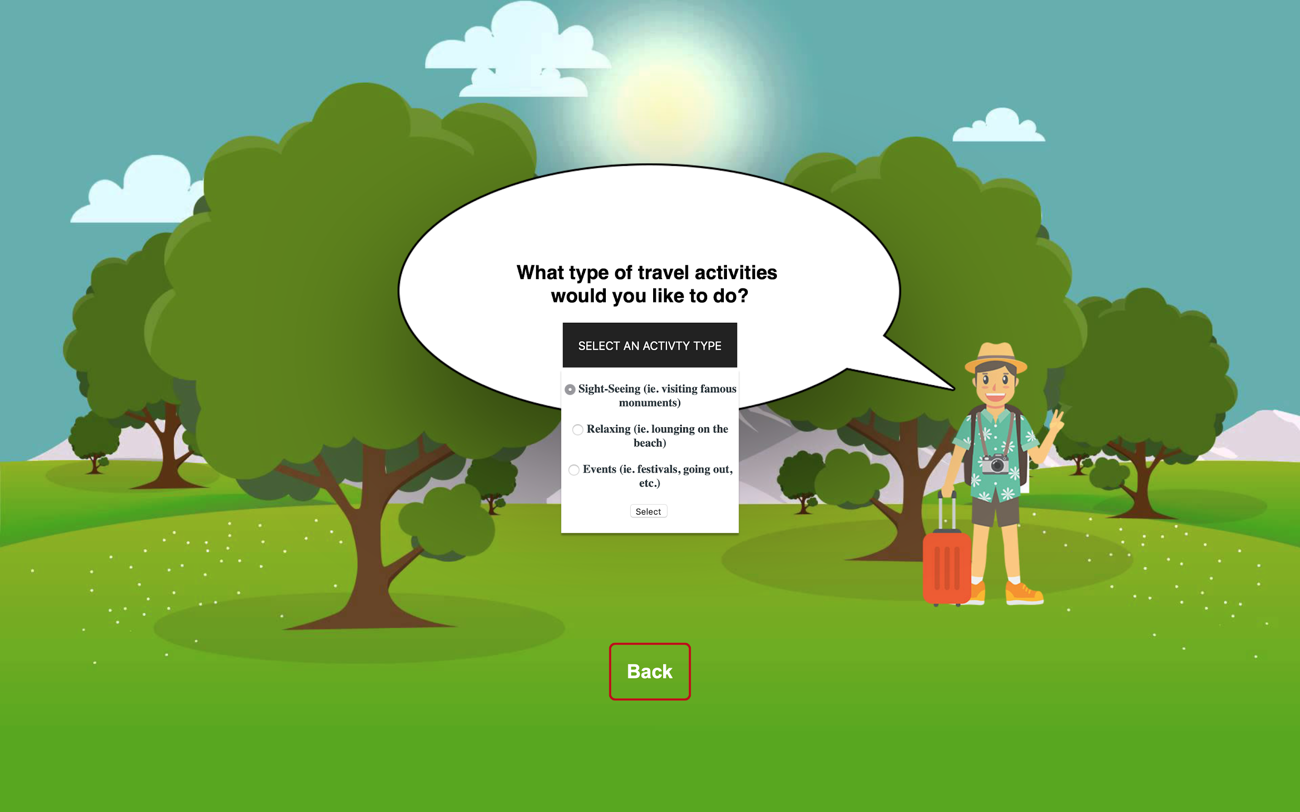
MVP 2 - Interface

Slide 7
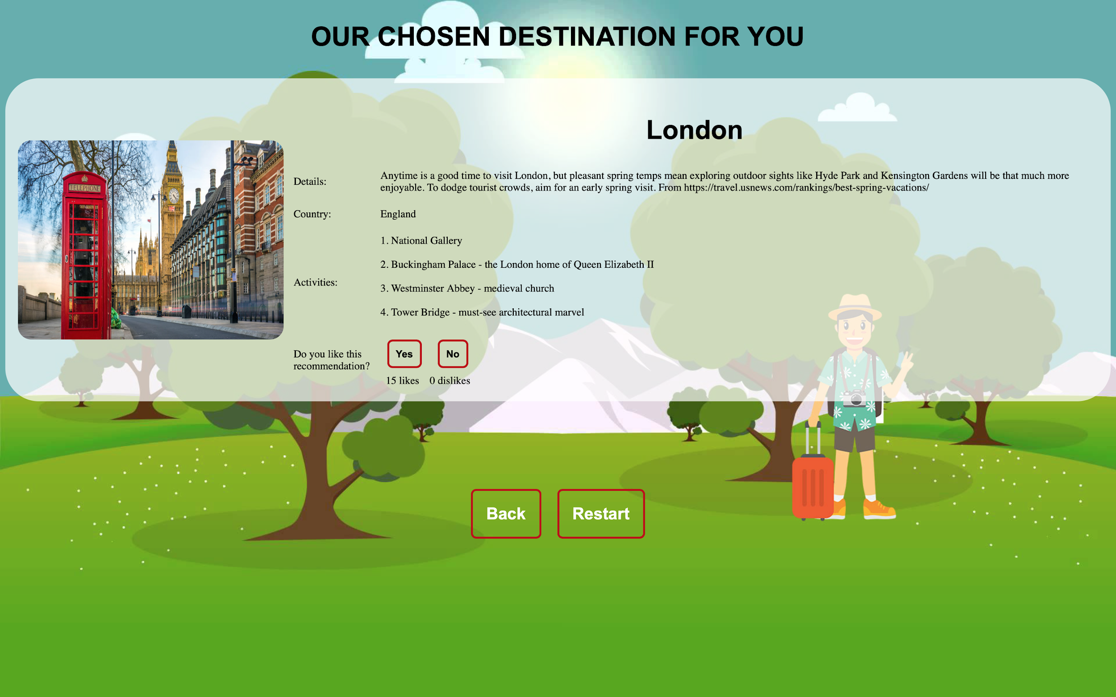
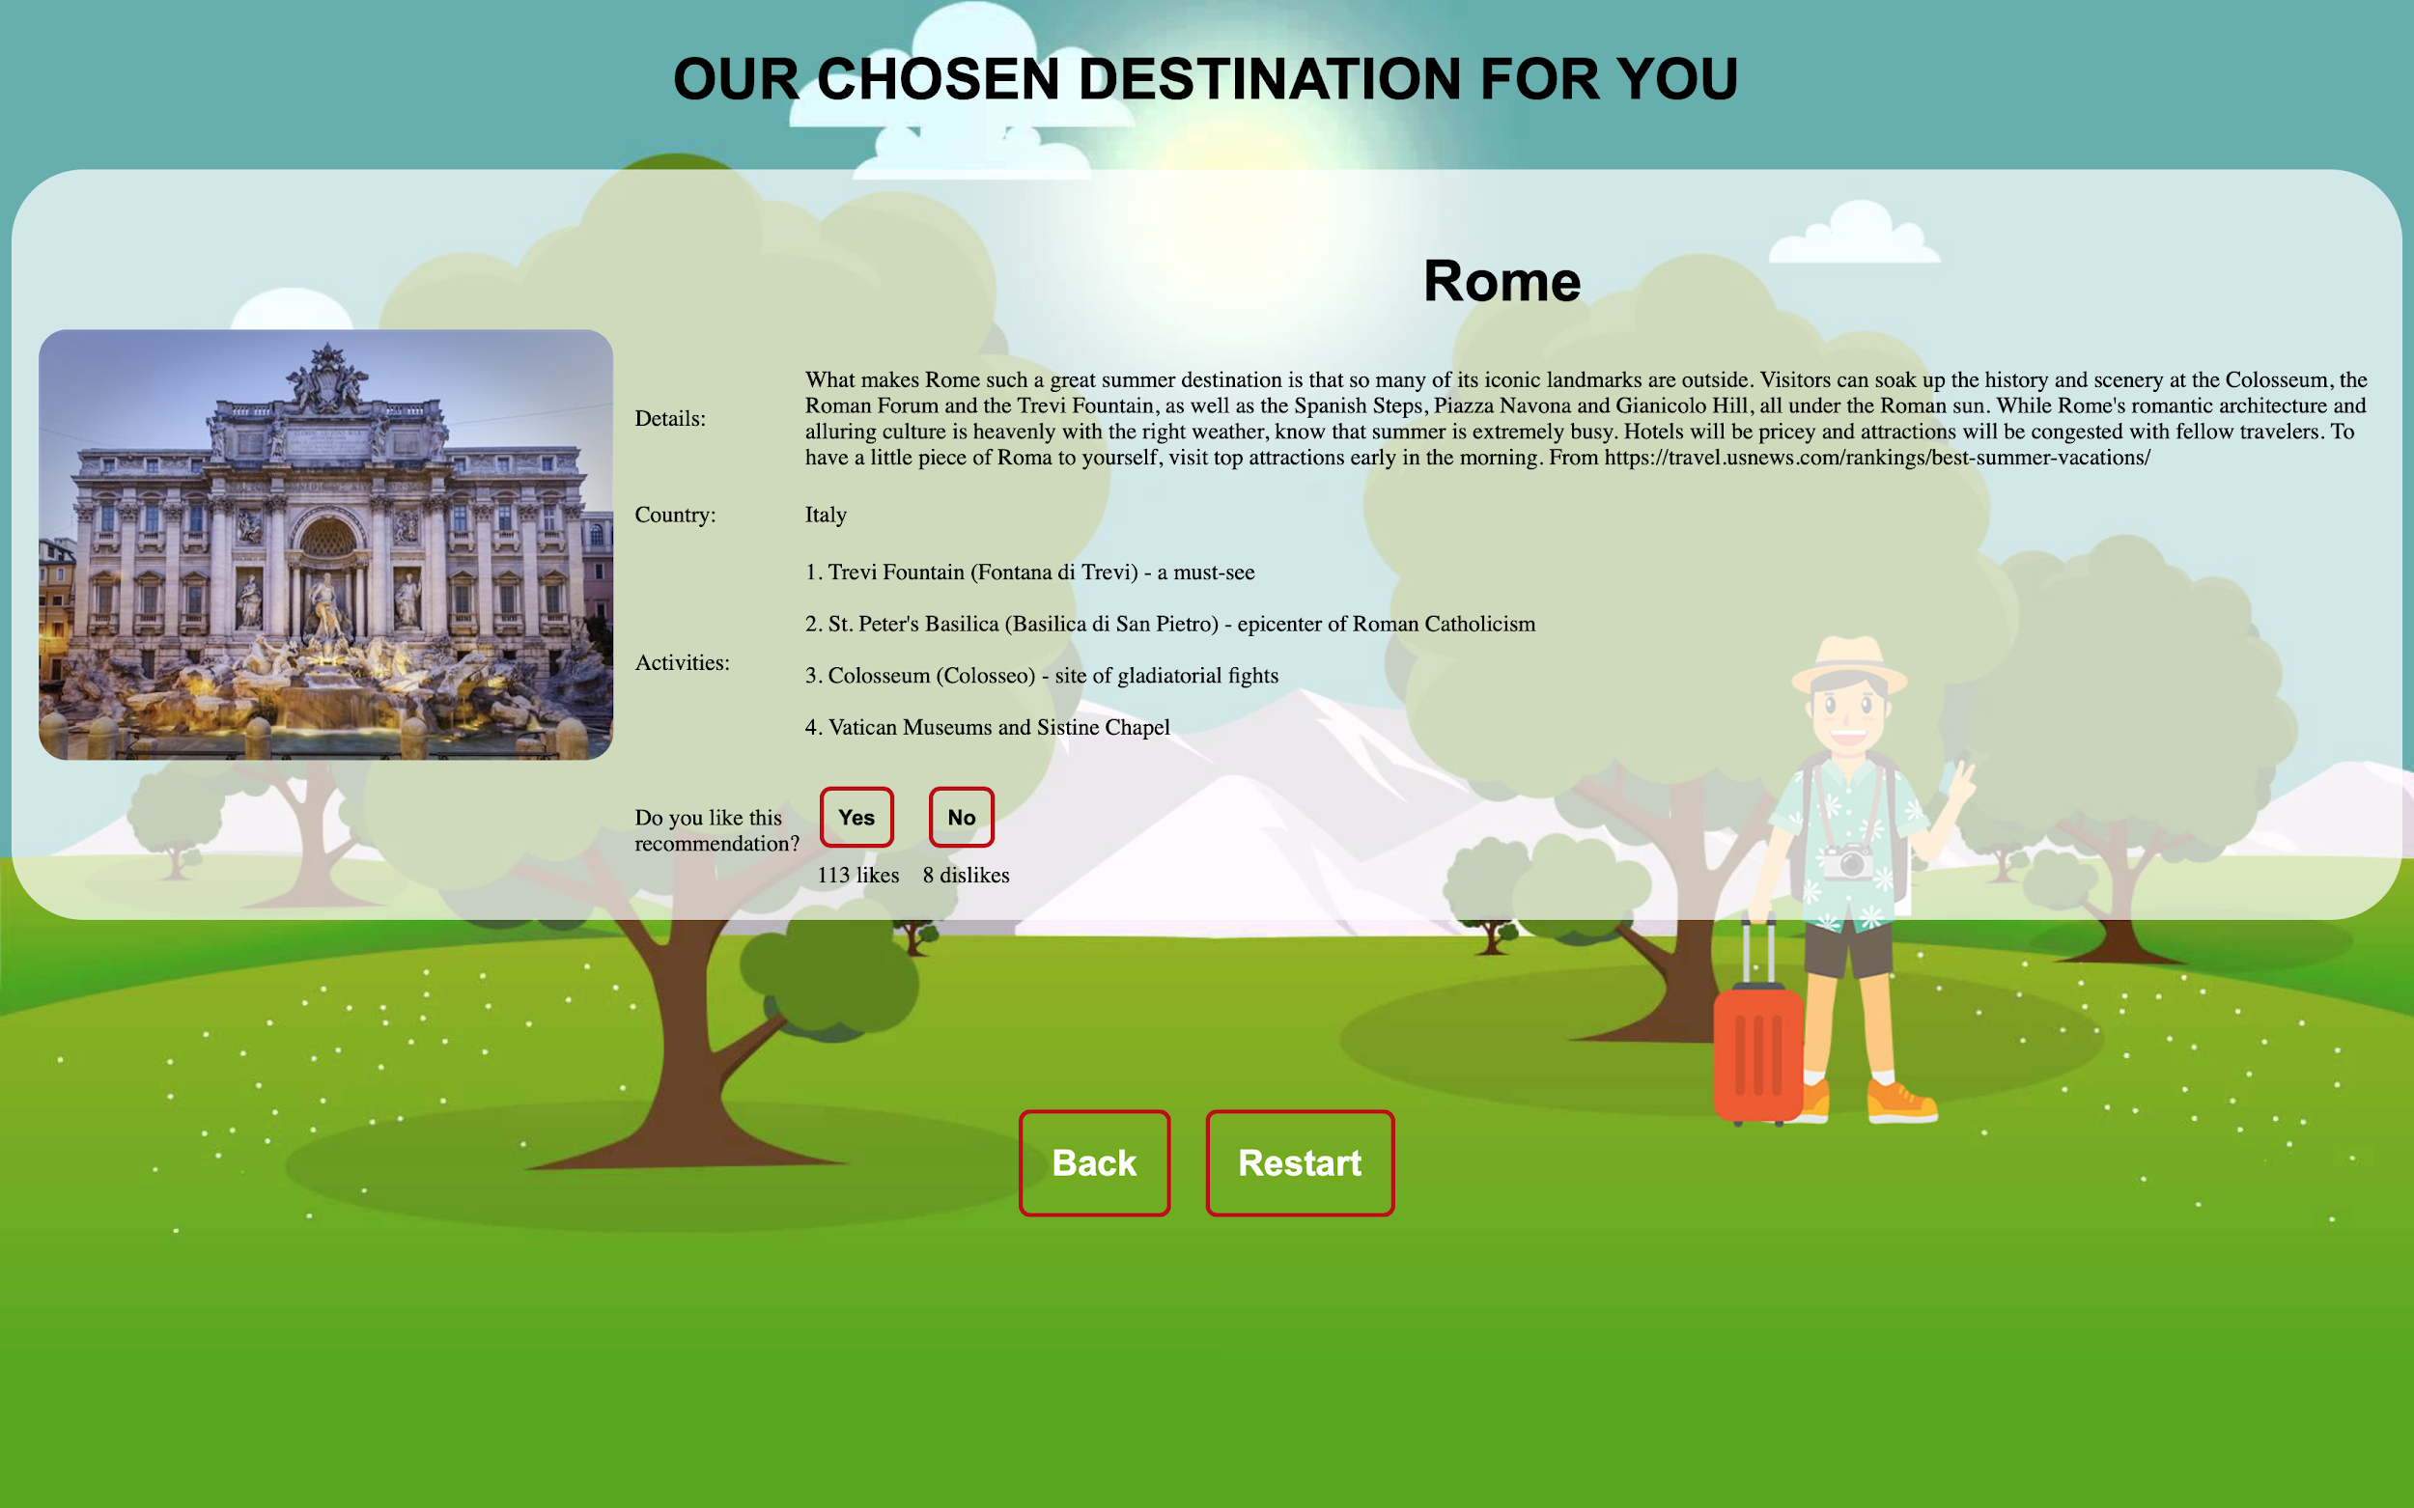
MVP 2 - Interface

Slide 8
MVP 2 Demo
Demo
MVP 1
Things we really liked: the home page, ease of use
Room for Improvement: destination recommendation interface, more location details
MVP 2
Good MVP? Yes -> clean interface, easy to use, provides a lot of location information for user, allows users to provide input on recommendations
Things we really like: improved destination interface, like/dislike option, ability to change choices without restarting
Room for Improvement (future MVPs): more preference selections, destination map, integration of more features such hotel booking

Slide 9
Feelings, Highlights, Better-Ifs
Success? We think so!
Highlights
Actually getting the application to work!
Successfully designing a clean and pleasing interface
Successfully mapping the users’ choices to unique locations
Providing quite a few details about the locations
“Better-Ifs”
There were more preferences that users could enter to affect the location recommendation
Location details don’t have to be found and entered into the database manually

Slide 10
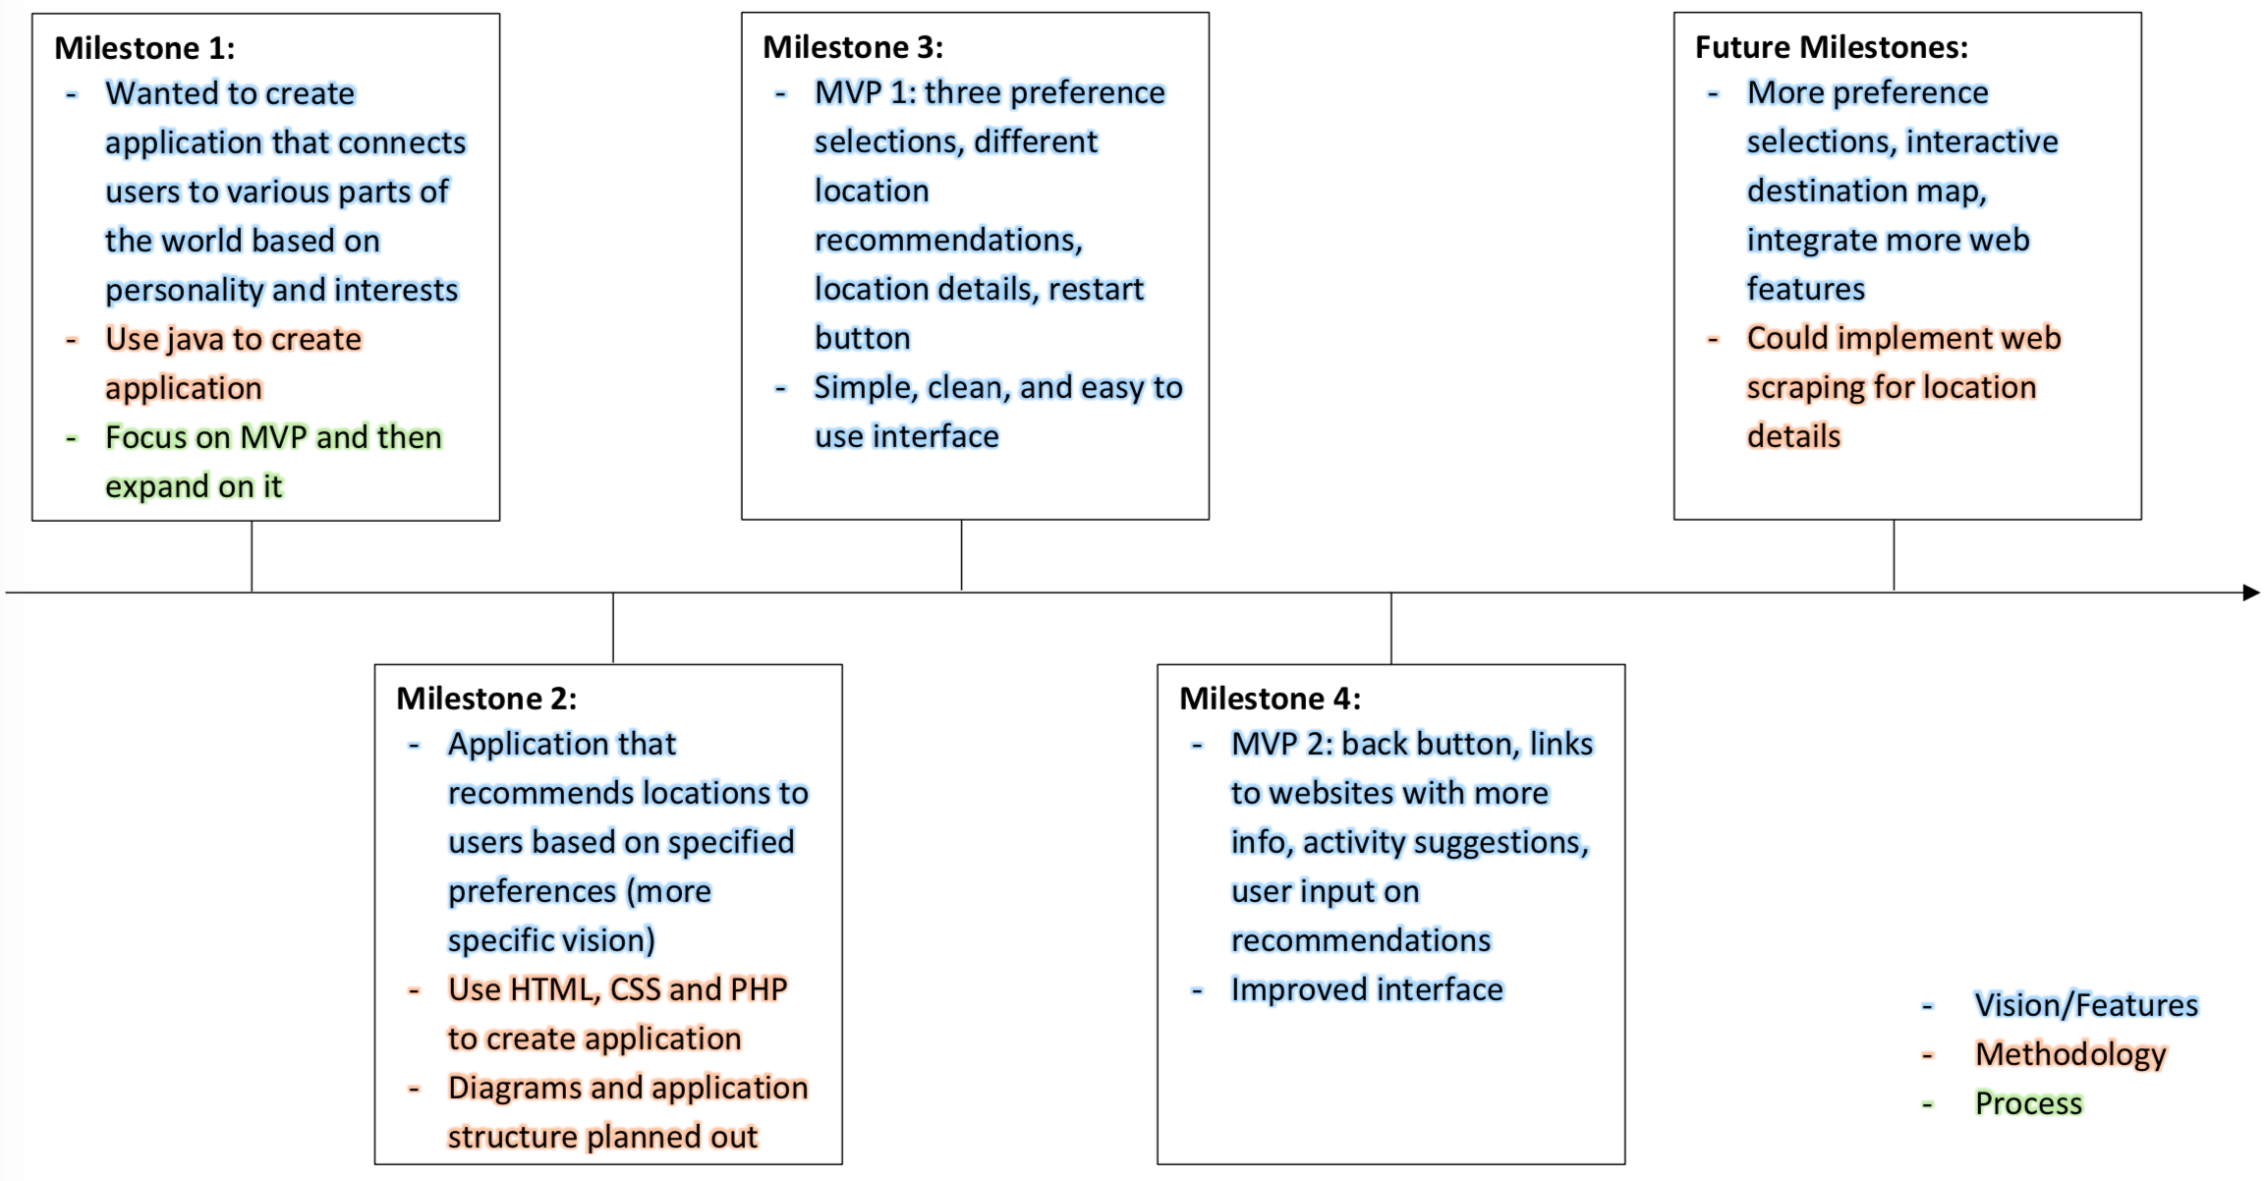
Changes/Shifts

Slide 11
Clean Code & Github
Clean Code? We think yes
Shorter variable names, camel case, short variable/html spans
Easy to read and understand
Single Responsibility: each element has only one purpose
Decoupling between pages
Concurrency: retrieves all the location recommendation details at once rather than individually
Github
File structure
Pick up where our project left off...

Slide 12
Group Reflection
How did you feel about this project? What did you like about it? What did you dislike?
We liked this project and that it allowed us to feel like we accomplished something. We disliked how rushed the overall project felt
What did you learn about yourself as you collaborated and worked through this project?
We picked up and finished each other’s parts when needed in order to get everything finished on time and communication is key
How will you use what you have learned going forward?
Make sure there is good communication between all group members in any project
What “stuff & things” related to this project would you want help with? – Could have been better?
More specific instructions and guidelines in the beginning - the broad and open-endedness made it difficult to know whether our idea was a good choice

